Slide 1

LOADING…

Slide 2

KONSER ONLINE
Among Dev Present – LAMPUNG

Slide 3
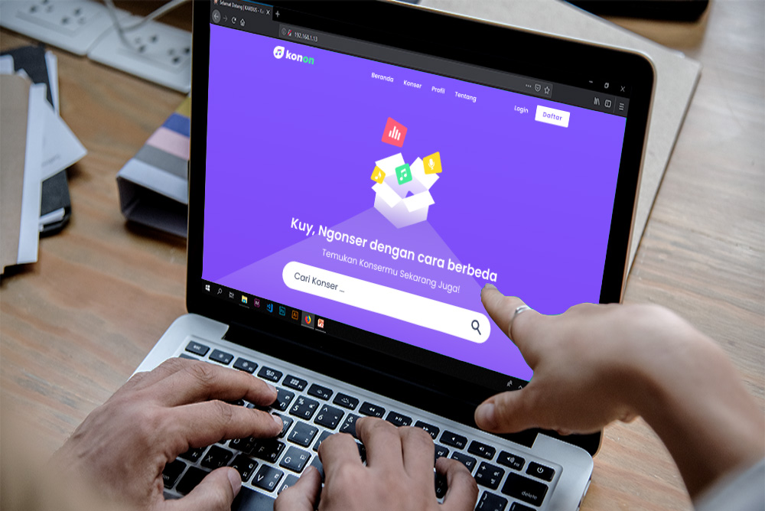
KONSER ONLINE
Among Dev Present – LAMPUNG

Slide 4
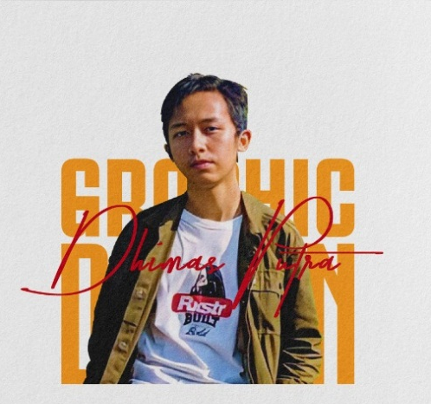



Tim Pengembang
Graphic Design
Back-end
Programmer
Graphic Design
Front-end
Programmer
Among Dev Present – LAMPUNG

Slide 5
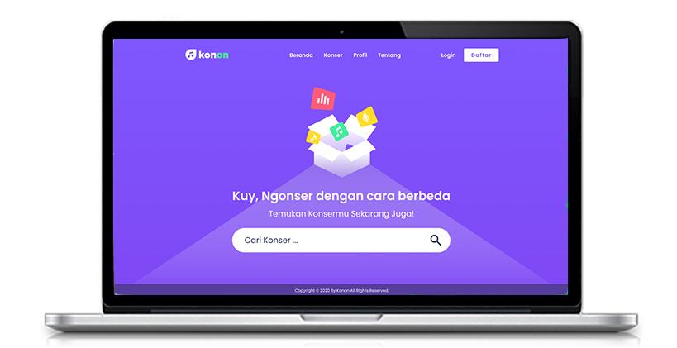
Apa Itu
KONON
?
Platform Konser Online
1
AR & VR Technology
2
3
Tiket Konser Online
Among Dev Present – LAMPUNG

Slide 6



Yang Kami Gunakan ?
01
Node JS
03
Ar JS
02
Vue JS
Among Dev Present – LAMPUNG

Slide 7
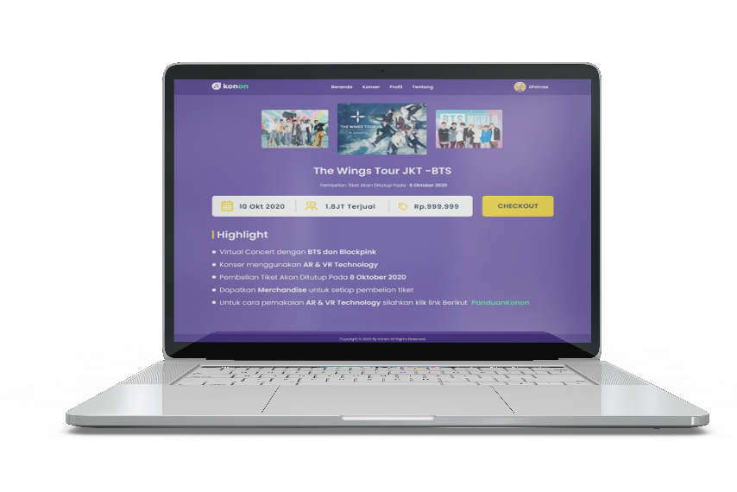
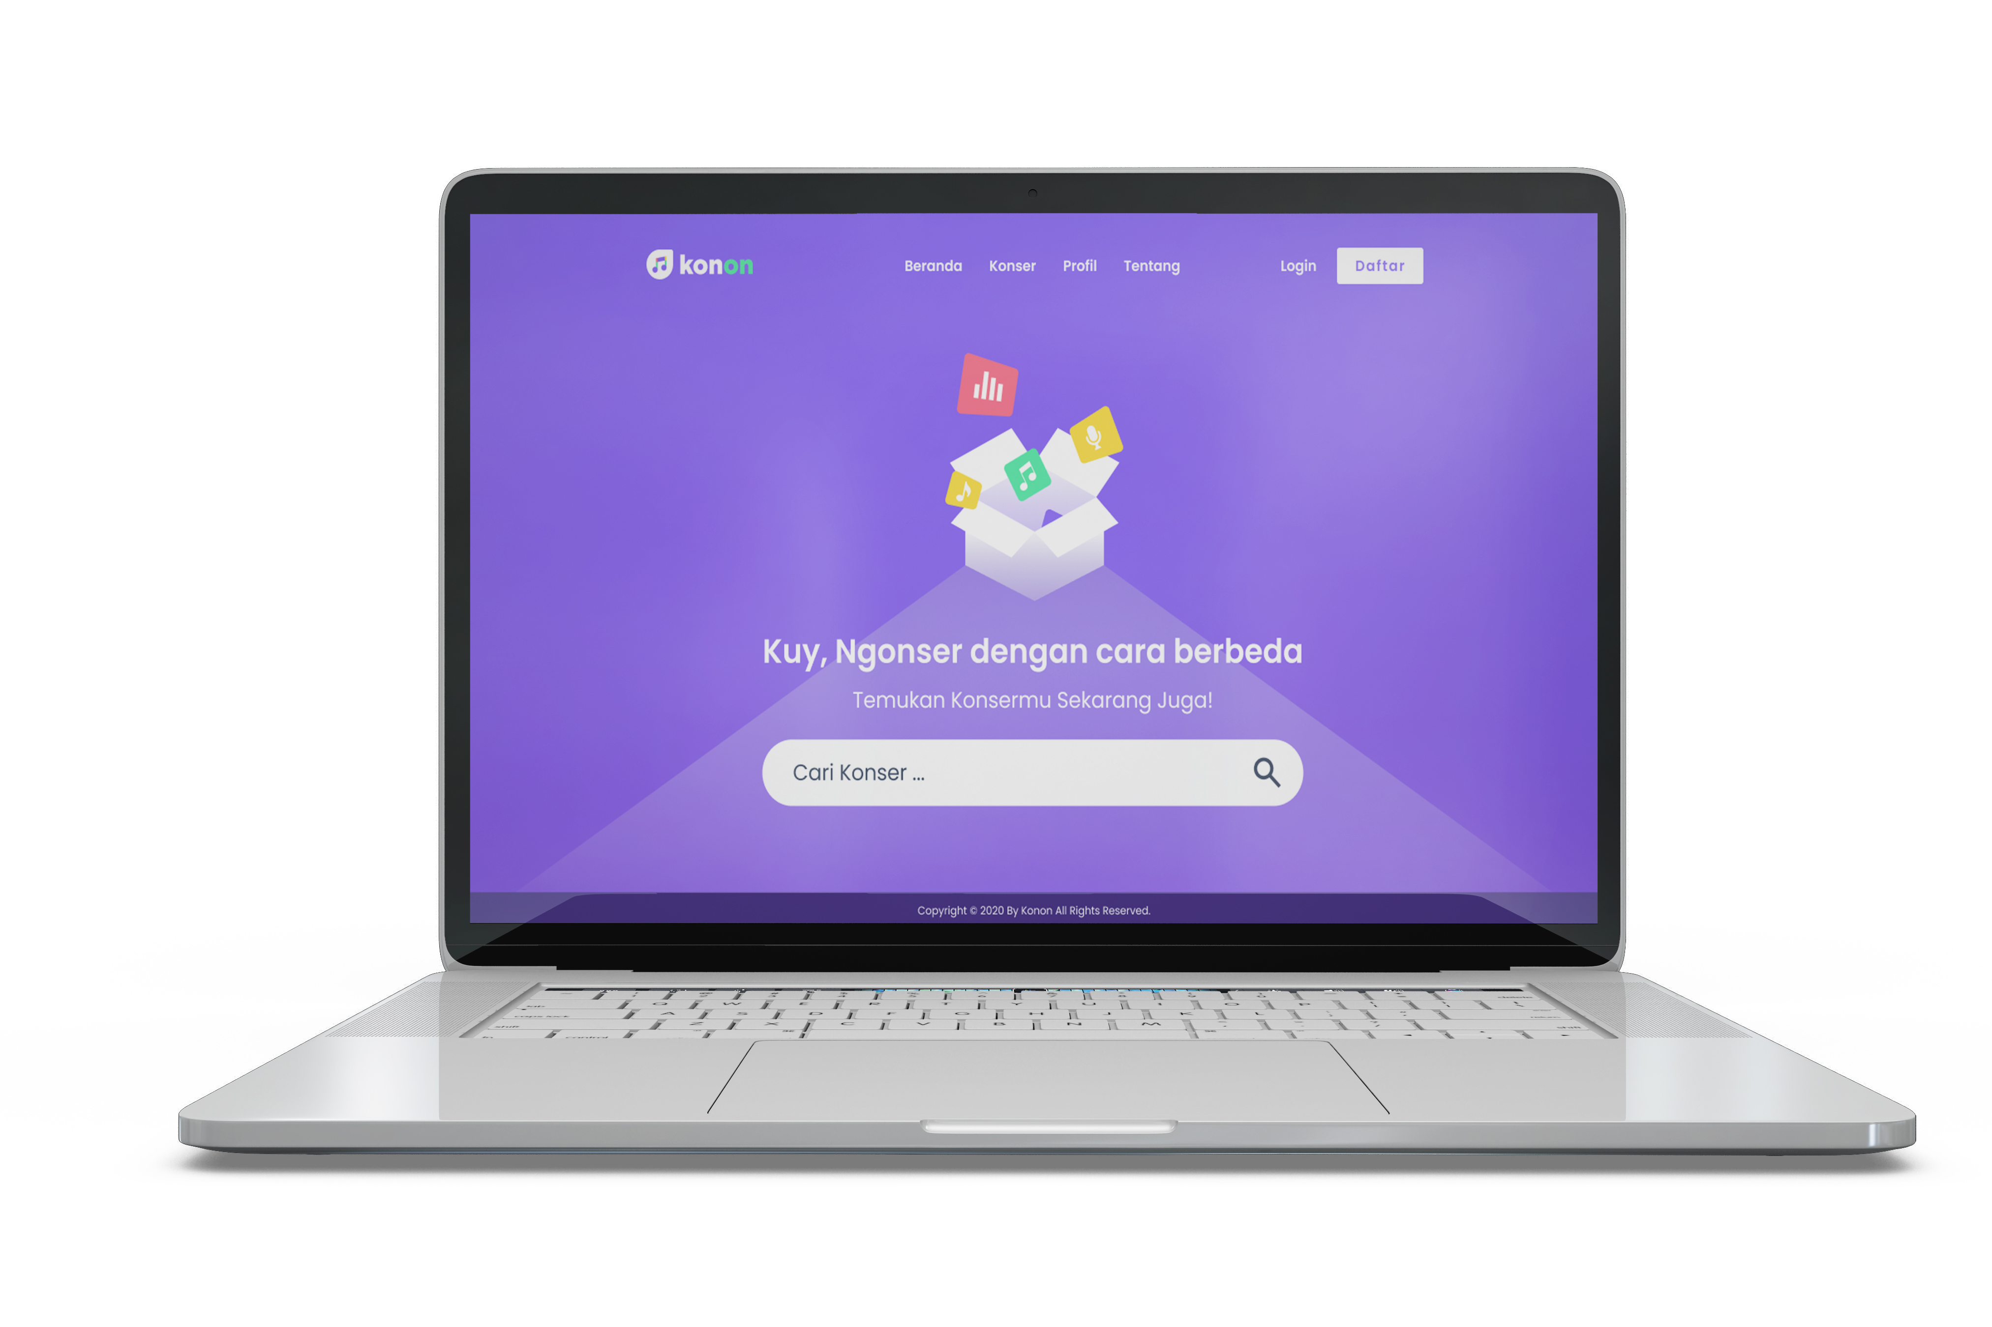
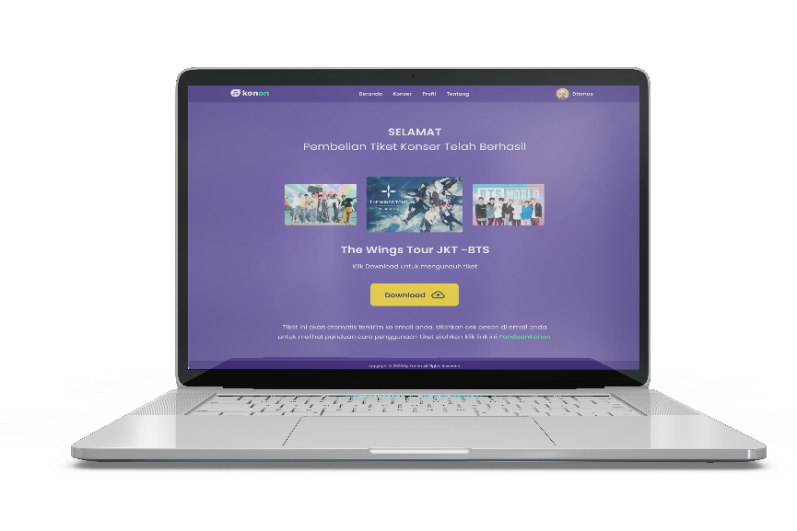
Prototype Desktop
View Konser
Halaman Utama
View Ticket
Among Dev Present – LAMPUNG

Slide 8
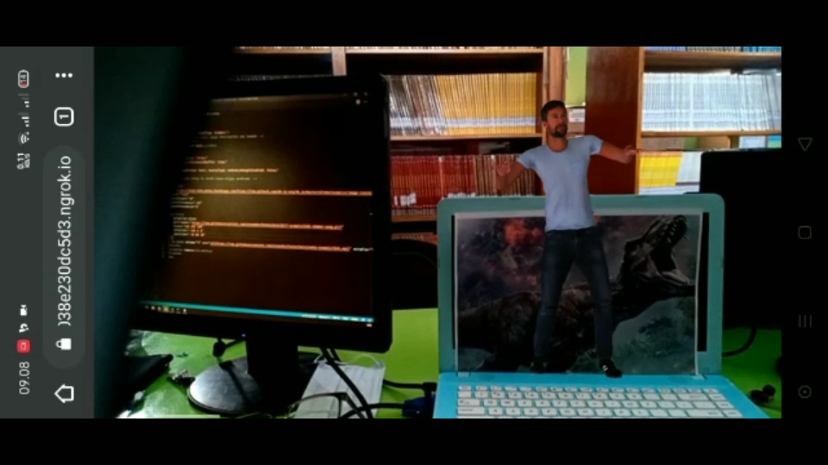
AR Result

Slide 9
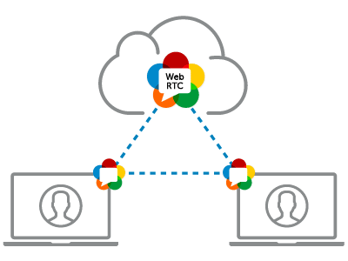
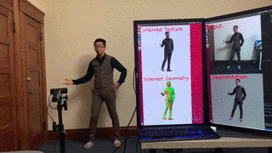
Rencana Pengembangan Selanjutnya
RTC
Pifu HD

Slide 10
TERIMA KASIH
AMONG DEV – LAMPUNG

